Slide 1
OpenGL lab#5 (Viewing transformation)
Computer Graphics

Slide 2
Cube Model
vertices = ((-1.0,-1.0,-1.0),(1.0,-1.0,-1.0),
(1.0,1.0,-1.0), (-1.0,1.0,-1.0), (-1.0,-1.0,1.0),
(1.0,-1.0,1.0), (1.0,1.0,1.0), (-1.0,1.0,1.0))
colors = ((0.0,0.0,0.0),(1.0,0.0,0.0),
(1.0,1.0,0.0), (0.0,1.0,0.0), (0.0,0.0,1.0),
(1.0,0.0,1.0), (1.0,1.0,1.0), (0.0,1.0,1.0))

Slide 3
Polygon 생성
블록 내의 정점들로 무엇을 어떻게 그릴 것인지를 결정
def polygon( a, b, c , d):
glBegin(GL_POLYGON)
glColor3fv(colors[a])
glVertex3fv(vertices[a])
glColor3fv(colors[b])
glVertex3fv(vertices[b])
glColor3fv(colors[c])
glVertex3fv(vertices[c])
glColor3fv(colors[d])
glVertex3fv(vertices[d])
glEnd()

Slide 4
Polygon 생성
블록 내의 정점들로 무엇을 어떻게 그릴 것인지를 결정
4: [-1, -1, 1]
7: [-1, 1, 1]
5: [1, -1, 1]
6: [1, 1, 1]
0: [-1, -1, -1]
3: [-1, 1, -1]
2: [1, 1, -1]
1: [1, -1, -1]

Slide 5
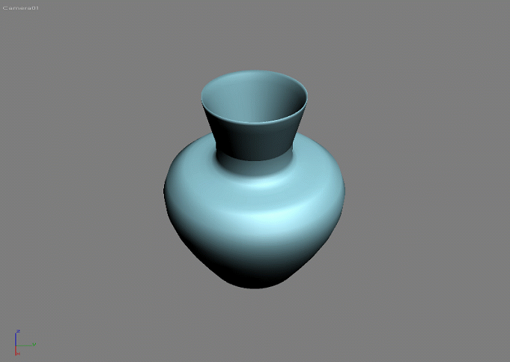
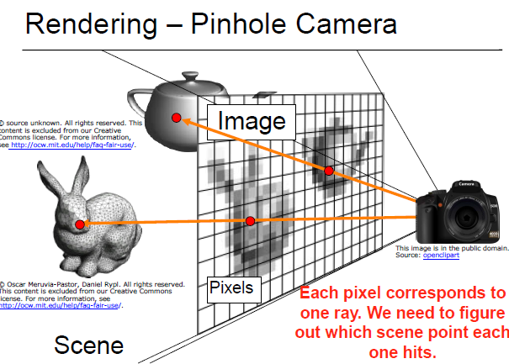
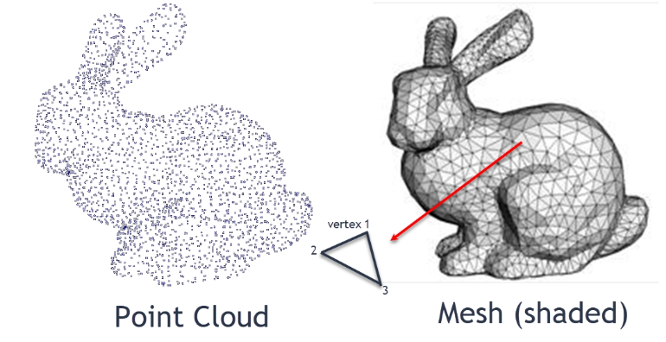
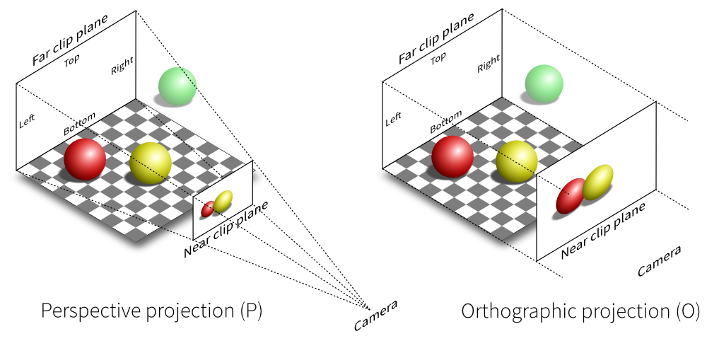
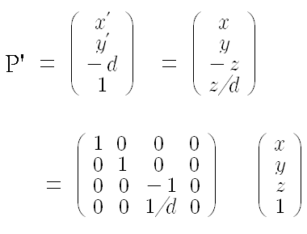
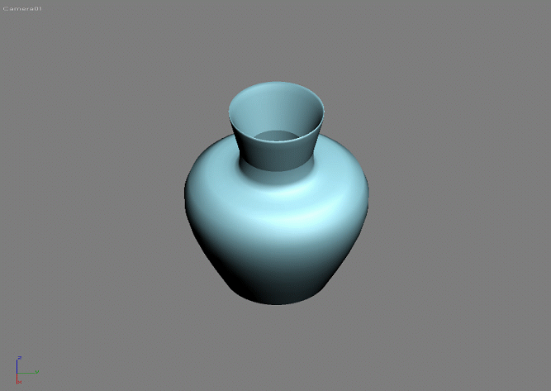
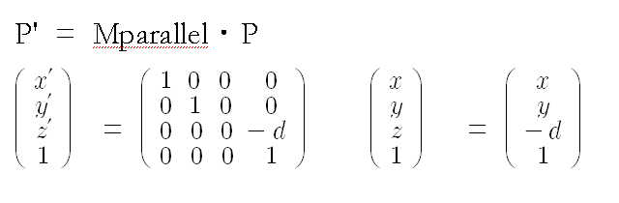
Projection, 투상변환
Perspective Projection
Rendering
Orthographic Projection

Slide 6
Viewing Transformation
Initial position of camera:
Camera position : 0.0, 0.0, 0.0
Viewing position : 0.0, 0.0, -1.0
Up vector : 0.0 1.0 0.0
glLookAt(eyex, eyey, eyez, atx, aty, atz, upx, upy, upz);
Camera position : eyex, eyey, eyez
Viewing position : atx, aty, atz
UP vector : upx, upy, upz
Camera up : a vector from camera position and up vector
Default view volume
glOrtho(-1.0, 1.0, -1.0, 1.0, -1.0, 1.0);

Slide 7
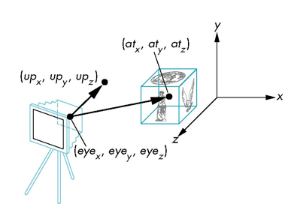
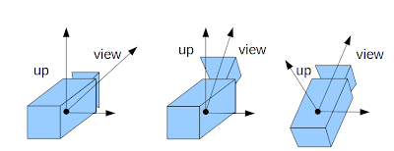
Viewing Transformation
glLookAt(eyex, eyey, eyez, atx, aty, atz, upx, upy, upz);
Camera position : eyex, eyey, eyez
Viewing position : atx, aty, atz
UP vector : upx, upy, upz
Camera up : a vector from camera position and up vector

Slide 8
Viewing Transformation
def MyDisplay():
global myview
glClear(GL_COLOR_BUFFER_BIT | GL_DEPTH_BUFFER_BIT)
glLoadIdentity()
if myview == 0: # front view
gluLookAt(0.0, 0.0, 5.0, 0.0, 0.0, 0.0, 0.0, 1.0, 0.0)
elif myview == 1: # top view
gluLookAt( )
elif myview == 2: # side view
gluLookAt( )
elif myview == 3: # perspective view
gluLookAt( )
colorcube()
glutSwapBuffers()}

Slide 9
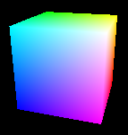
Viewing Transformation
Y
Top View
X
Side View
Z
Front View

Slide 10
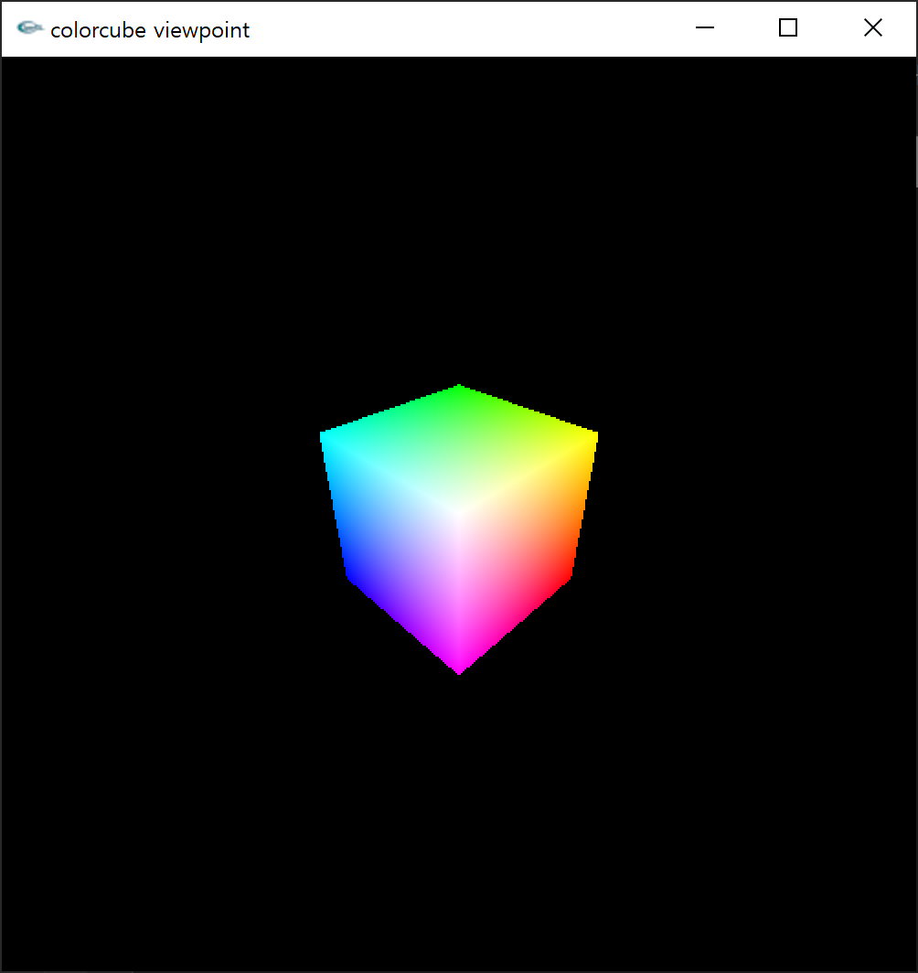
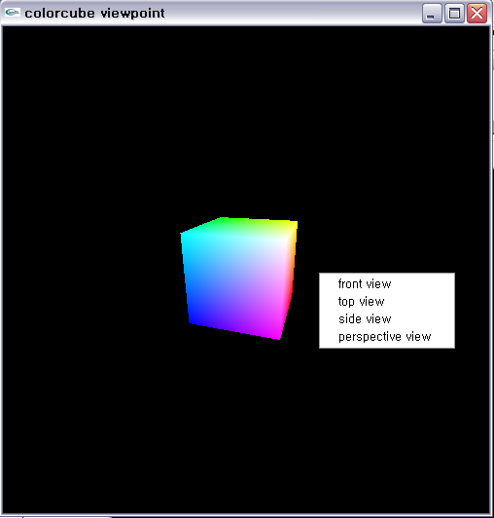
Lab#5
정의된 정육면체의 Front View, Top view, Side View, Perspective View를 보여주는 코드 작성

Slide 11
제출
보고서 내용 (pdf)
문제에서 요구하는 각 세부 기능 설명
기능별 실행 화면 캡춰
전체 프로그램 코드
보고서 pdf (lab0#_학번_이름.pdf)
실행파일 (lab0#_학번_이름.py)
위의 2개 파일을 zip으로 압축(lab0#_학번_이름.zip)

